Slide 1
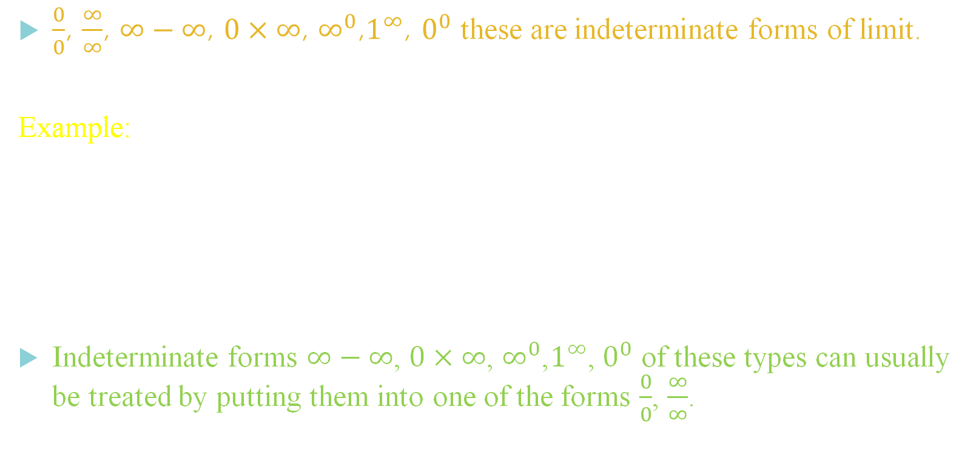
Indeterminate Forms
$\frac{0}{0}$, $\frac{∞}{∞}$, $∞−∞$, $0×∞$, $∞^{0}$,$1^{∞}$, $0^{0}$ these are indeterminate forms of limit.
Example:
Let f(x) and g(x) be two functions such that and $\log_{x→a}{g(x)}=0$ and $\log_{x→a}{f(x)}=0$. Then the function $\frac{f(x)}{g(x)}$ has the indeterminate form $\frac{0}{0}$ at $x=a$.
Indeterminate forms $∞−∞$, $0×∞$, $∞^{0}$,$1^{∞}$, $0^{0}$ of these types can usually be treated by putting them into one of the forms $\frac{0}{0}$, $\frac{∞}{∞}$.

Slide 2

L’Hospital’s Rule
Suppose that we have one of the following cases,
$\lim_{x→a}{\frac{f(x)}{g(x)}= \frac{0}{0}}$ OR $\lim_{x→a}{\frac{f(x)}{g(x)}= \frac{±∞}{±∞}}$
Where a can be any real number, infinity or negative infinity. In these cases we have,
$\lim_{x→a}{\frac{f(x)}{g(x)}= }\lim_{x→a}{\frac{f′(x)}{g′(x)}}$
There are seven indeterminate forms of limits
$$\frac{0}{0},\frac{∞}{∞}, 0×∞, ∞−∞, ∞^{0}, 1^{∞}, 0^{0}$$

Slide 3


Examples of the form $\frac{0}{0}$ and $\frac{∞}{∞}$
Evaluate following limits:
$\lim_{x→0}{\frac{{\left(1+x\right)}^{n}−1}{x}}$
$L=\lim_{x→0}{\frac{{\left(1+x\right)}^{n}−1}{x}}$
Put $x=0$
=> $L=\frac{{\left(1+0\right)}^{n}−1}{0}$
=> $L=\frac{0}{0}$
There fore L’Hospital’s Rule can be used
$\lim_{x→0}{\frac{{\left(1+x\right)}^{n}−1}{x}}$ = $\lim_{n→0}{\frac{n{\left(1+x\right)}^{n−1}}{1}}$
$=\frac{n{\left(1+0\right)}^{n−1}}{1}$
$\lim_{x→0}{\frac{{\left(1+x\right)}^{n}−1}{x}}=n$

Slide 4

$L=\lim_{x→0}{\frac{xe^{x}−log⁡(1+x)}{x^{2}}}$
Plugging x = 0 we get $\frac{0}{0}$ form
Applying L’Hospital Rule, We get
$L=\lim_{x→0}{\frac{xe^{x}+e^{x}−\frac{1}{⁡(1+x)}}{2x}}$
Again by plugging x = 0 we get $\frac{0}{0}$ form
Applying L’Hospital Rule, We get
$L=\lim_{x→0}{\frac{xe^{x}+e^{x}+e^{x}+\frac{1}{{\left(1+x\right)}^{2}}}{2}}$
$L=\frac{0+1+1+1}{2}$
$\lim_{x→0}{\frac{xe^{x}−log⁡(1+x)}{x^{2}}}=\frac{3}{2}$
$L=\lim_{x→0}{\log_{\tan{x}}{\tan{4x}}}$
$L=\lim_{x→0}{\frac{\log_{e}{\tan{4x}}}{\log_{e}{\tan{x}}}}$
Plugging x = 0 we get $\frac{∞}{∞}$ form
Applying L’Hospital Rule, We get
$L=\lim_{x→0}{\frac{\frac{1}{\tan{4x}}×4\sec^{2}{4x}}{\frac{1}{\tan{x}}×\sec^{2}{x}}}$
$L=\lim_{x→0}{\frac{\tan{x}}{\tan{4x}}}\lim_{x→0}{4\frac{\sec^{2}{4x}}{sec^{2}x}}$
$L=\frac{1}{4}\lim_{x→0}{\frac{\frac{\tan{x}}{x}}{\frac{\tan{4x}}{4x}}}×4$
$L=\frac{1}{4}×\frac{1}{1}×4$
$\lim_{x→0}{\log_{\tan{x}}{\tan{4x}}} \text{= 1}$

Slide 5

$L=\lim_{x→0}{\frac{\log{\tan{x}}}{\log{x}}}$
Plugging x = 0 we get $\frac{∞}{∞}$ form
Applying L’Hospital Rule, We get
$L=\lim_{x→0}{\frac{\frac{1}{\tan{x}}\sec^{2}{x}}{\frac{1}{x}}}$
$L=\lim_{x→0}{\frac{x}{\tan{x}}}× \lim_{x→0}{\sec^{2}{x}}$
$L=1×1$
$\lim_{x→0}{\frac{\log{\tan{x}}}{\log{x}}}=1$
Find a and b if $\lim_{x→0}{\frac{x\left(1+a cos{x}\right)−b\sin{x}}{x^{3}}}=1$
If $\lim_{x→0}{\frac{\sin{2x}+p\sin{x}}{x^{3}}}$ is finite then find the value of $p$ and hence the value of the limit.
Using Taylor series evaluate following limit $\lim_{x→0}{\frac{{\left(1+x\right)}^{n}−1}{x}}$
Evaluate $\lim_{x→\frac{π}{2}}{\frac{\tan{3x}}{\tan{x}}}$ Ans: $\frac{1}{3}$

Slide 6

Examples of the form $0×∞$ and $∞−∞$
Evaluate $\lim_{x→0}{\sin{x}}\log{x}$.
$L=\lim_{x→0}{\sin{x}}\log{x}$
Plugging x = 0 we get $0×∞$ form
$L=\lim_{x→0}{\frac{\log{x}}{cosec x}}$
Now plugging x = 0 we get $\frac{∞}{∞}$ form
Applying L’Hospital Rule, We get
$L=\lim_{x→0}{\frac{\frac{1}{x}}{−cosec x\cot{x}}}=\lim_{x→0}\left(\frac{−\sin^{2}{x}}{x\cos{x}}\right)$
plugging x= 0 above we get $\frac{0}{0}$ form
Apply L’Hospital Rule
$L=\lim_{x→0} (\frac{−2\sin{x}\cos{x}}{\cos{x}−x\sin{x}})$
$L=−\frac{0}{1−0}$
$\lim_{x→0}{\sin{x}}\log{x}=0$
Evaluate $\lim_{x→0}{x^{m}}{\left(\log{x}\right)}^{n}$, where m, n are positive integers.
Ans:$L=0$
Evaluate $\lim_{x→0}\left\{x−x^{2}log⁡(1+\frac{1}{x})\right\}$
Hint: make substitution $x=\frac{1}{y}$
Ans:$L=\frac{1}{2}$

Slide 7

4. Evaluate $\lim_{x→∞}{\cosh^{−1}{x}{−}}\log{x}$.
$L=\lim_{x→∞}{\cosh^{−1}{x}{−}{\log{x}}}$
Plugging $x=∞$ we get $∞−∞$ form
$L=\lim_{x→∞}{log⁡(x+\sqrt{x^{2}−1})}−\log{x}$
$L=\lim_{x→∞}{log(\frac{\left(x+\sqrt{x^{2}−1}\right)}{x})}$
$L=\lim_{x→∞}{\log{(1+\sqrt{1−\left(\frac{1}{x^{2}}\right)})}}$
$\lim_{x→∞}{\cosh^{−1}{x}{−}}\log{x}=$ $\log{2}$
5. Prove that $\lim_{x→1}{[\frac{x}{x−1}−\frac{1}{\log{x}}]}=\frac{1}{2}$. 6. Evaluate following limit $\lim_{x→\frac{π}{2}}{(\sec{x}−\tan{x})}$. Ans: $L=0$

Slide 8


Examples of the form $0^{0}$, $∞^{0}$ and $1^{∞}$.
Evaluate $\lim_{x→0}{{\left(\cos{x}\right)}^{\frac{1}{x}}}$
$L=\lim_{x→0}{{\left(\cos{x}\right)}^{\frac{1}{x}}}$
By plugging $x=0$ we get limit value $1^{∞}$
which is an indeterminate form
Let's convert that is in $\frac{0}{0}$
Appling log on both side, we get
$\log{L}=\lim_{x→0}\frac{1}{x}\log{\cos{x}}=\lim_{x→0}\frac{\log{\cos{x}}}{x}$
Now plugging $x=0$ we get $\frac{0}{0}$
Now let's Apply L’Hospital Rule
$\log{L}=\lim_{x→0}\frac{\frac{1}{\cos{x}}×\left(−\sin{x}\right)}{1}$
Now plug $x=0$
$\log{L}=\frac{\frac{1}{1}×\left(−0\right)}{1}=0$
But we need to find L
Therefore $L=e^{0}=1$
$\lim_{x→0}{{\left(\cos{x}\right)}^{\frac{1}{x}}}=1$
Evaluate $\lim_{x→\frac{π}{2}}{{\left(\cos{x}\right)}^{\cos{x}}}$
$L=\lim_{x→\frac{π}{2}}{{\left(\cos{x}\right)}^{\cos{x}}}$
By plugging $x=\frac{π}{2}$ we get limit value $0^{0}$
which is an indeterminate form.
Let's convert that is in $\frac{∞}{∞}$.

Slide 9

Appling log on both side, we get:
$\log{L}=\lim_{x→\frac{π}{2}}\cos{x}\log{\cos{x}}=\lim_{x→\frac{π}{2}}\frac{\log{\cos{x}}}{\sec{x}}$
Now plugging $x=\frac{π}{2}$ we get$\frac{∞}{∞}$.
Now let's Apply L’Hospital Rule
$\log{L}=\lim_{x→\frac{π}{2}}\frac{\frac{1}{\cos{x}}×\left(−\sin{x}\right)}{\sec{x}\tan{x}}=\lim_{x→\frac{π}{2}} −\frac{\sin{x}}{\tan{x}}$
Now plug $x=\frac{π}{2}$,
$\log{L}=\frac{\left(\left(−\sin{\frac{π}{2}}\right)\right)}{\frac{1}{0}}=\frac{1}{∞}=0$ $⇒L=1$.
$\lim_{x→\frac{π}{2}}{{\left(\cos{x}\right)}^{\cos{x}}}=1$
Evaluate $\lim_{x→0}{{\left(\cot{x}\right)}^{\sin{x}}}$
L $= \lim_{x→0}{{\left(\cot{x}\right)}^{\sin{x}}}$
By plugging $x=0$ we get limit value $∞^{0}$
which is an indeterminate form.
Let's convert that is in $\frac{∞}{∞}$.
Appling log on both side, we get:
$\log{L}=\lim_{x→0}\sin{x}\log{\cot{x}}=\lim_{x→0}\frac{\log{\cot{x}}}{\operatorname{cosec}{x}}$
Now plugging $x=0$ we get$\frac{∞}{∞}$.
Now let's Apply L’Hospital Rule
$\log{L}=\lim_{x→0}\frac{\frac{1}{\cot{x}}×\left(−cosec^{2} x\right)}{−\cot{x} cosec x}=\lim_{x→\frac{π}{2}} −\frac{\operatorname{cosec}{x}}{\cot^{2}{x}}$

Slide 10

$\log{L}=\lim_{x→0} −\frac{1}{cosec x \cos^{2}{x}}$
$\log{L}=−\frac{1}{∞×1}=0$
$L=e^{0}$
$\lim_{x→0}{{\left(\cot{x}\right)}^{\sin{x}}}=1$
Evaluate $\lim_{x→a}{{\left(x−a\right)}^{x−a}}$
Evaluate $\lim_{x→0}{{\left(1+\tan{x}\right)}^{\cot{x}}}$
Attempt: $\lim_{x→0}{{\left[\frac{a^{x}+b^{x}}{2}\right]}^{\frac{1}{x}}}$
Evaluate $\lim_{x→1}{{\left(1−x^{2}\right)}^{\frac{1}{\log{(1−x)}}}}$
Evaluate $\lim_{x→\frac{π}{2}}{{\left(\sec{x}\right)}^{\cot{x}}}$

